Slide 1









WELCOME TO THE
ROYAL PRINCE EDWARD
YACHT CLUB
COMBINED CLUBS' INSHORE SERIES
&
SYDNEY HARBOUR WOMEN'S KEELBOAT SERIES
PRIZE GIVING
21ST MAY 2026
◆

Slide 2

COMBINED CLUBS'
INSHORE SERIES
SEASON 2025–26

Slide 3
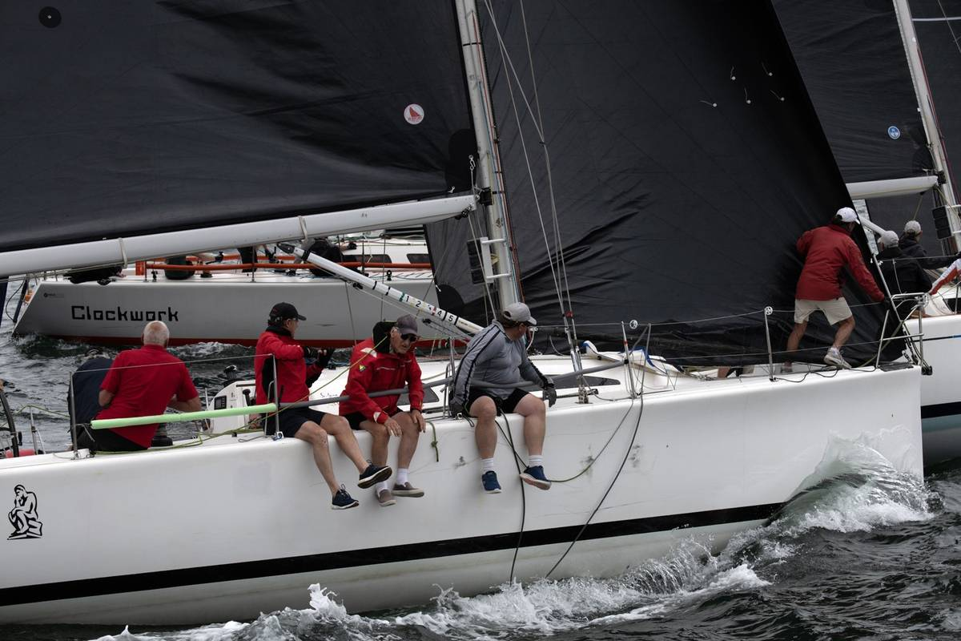

COMBINED CLUBS' INSHORE SERIES
◆
1st Place Division 1, PHS
◆
1st Place Division 1, IRC
ADVANCED PHILOSOPHY
Peter Sorensen
MHYC

Slide 4

COMBINED CLUBS' INSHORE SERIES
◆
2nd Place Division 1, PHS
HELLRAZER
Ian MacDiarmid
RSYS

Slide 5
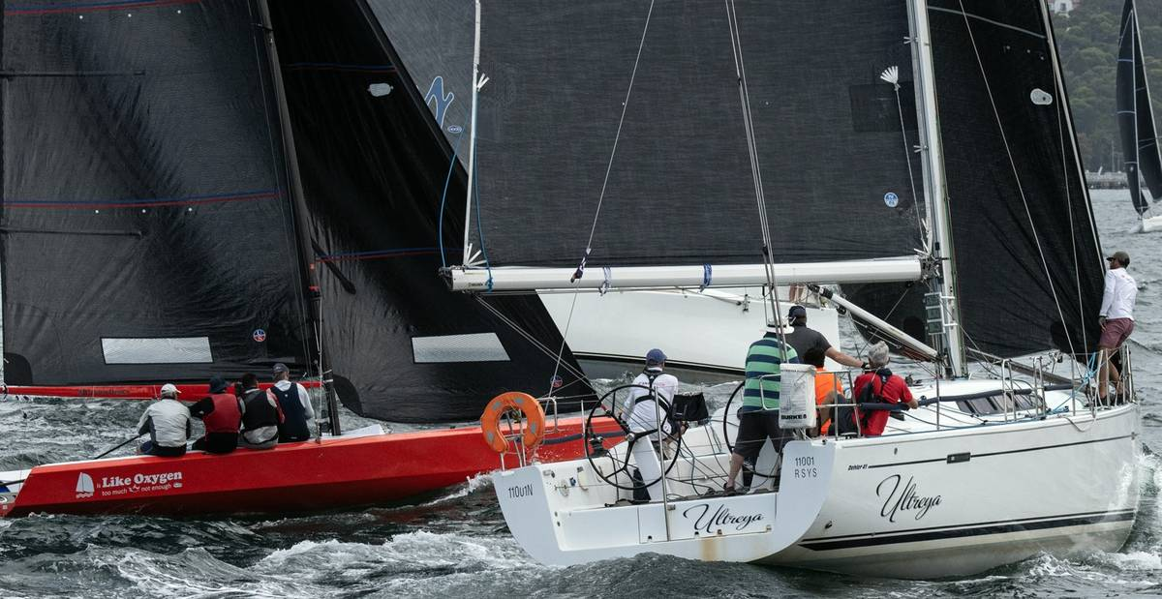
COMBINED CLUBS' INSHORE SERIES
◆
3rd Place Division 1, PHS
ULTREYA
Rod Pearse
RSYS

Slide 6
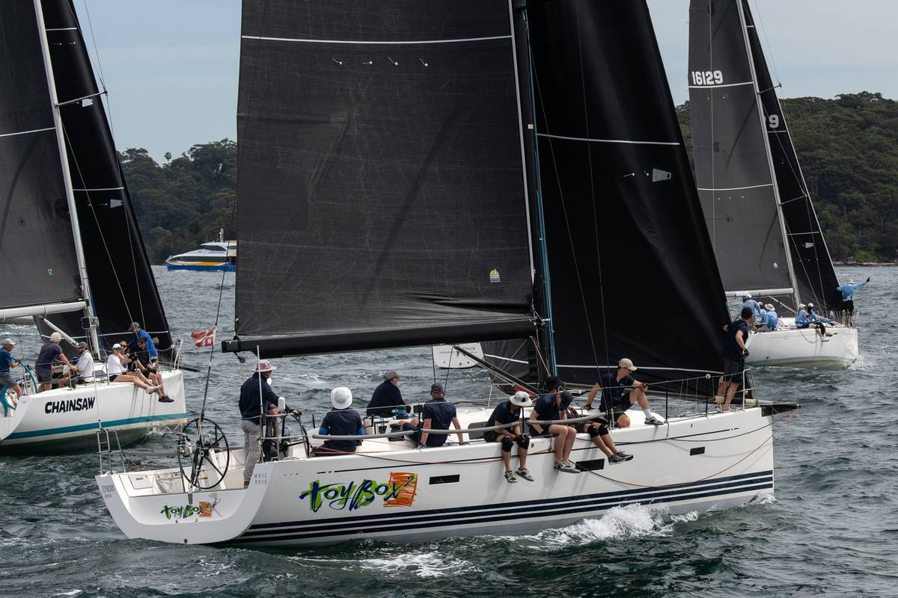
COMBINED CLUBS' INSHORE SERIES
◆
1st Place Division 1, ORC
◆
2nd Place Division 1, IRC
TOYBOX 2
Ian Box
MHYC

Slide 7

COMBINED CLUBS' INSHORE SERIES
◆
2nd Place Division 1, ORC
◆
3rd Place Division 1, IRC
WAILEA
Neil Padden
MHYC

Slide 8
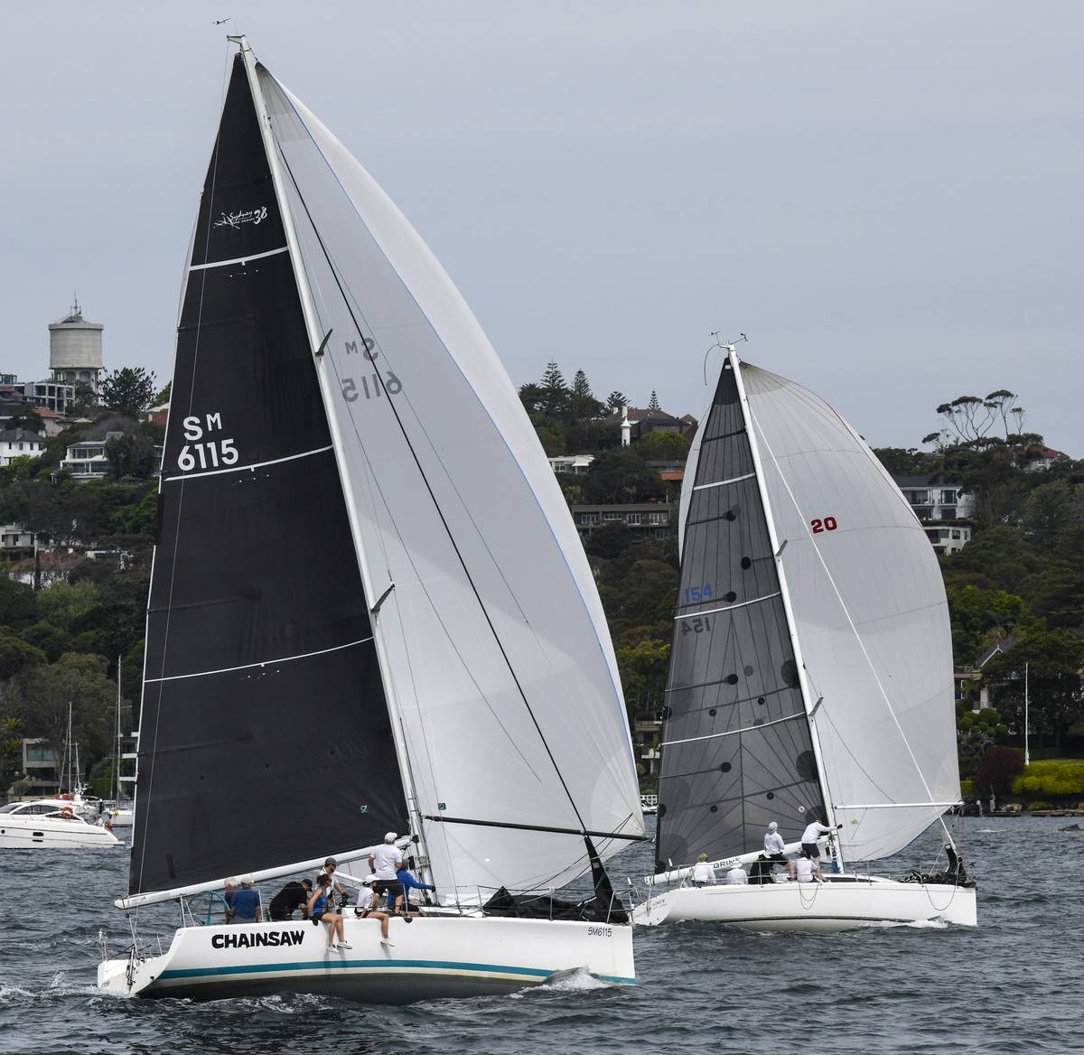
COMBINED CLUBS' INSHORE SERIES
◆
3rd Place Division 1, ORC
CHAINSAW
John Amos
RSYS

Slide 9
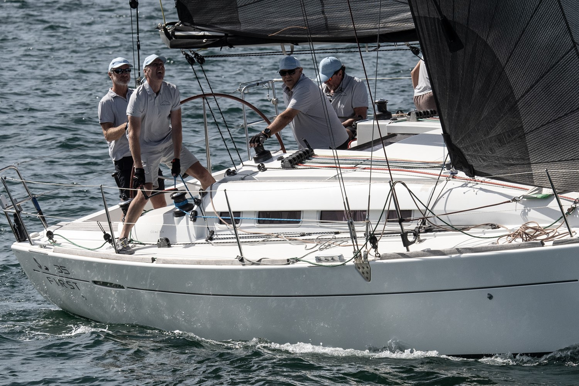
COMBINED CLUBS' INSHORE SERIES
◆
1st Place Division 2, PHS
◆
1st Place Division 2, ORC
ONE MORE NO MORE
David Seaton
RSYS

Slide 10
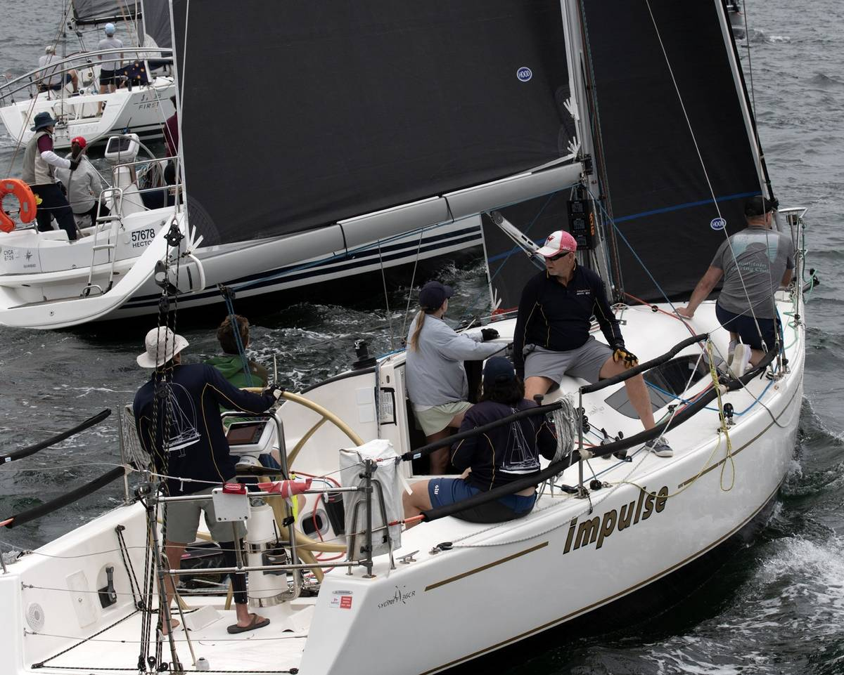
COMBINED CLUBS' INSHORE SERIES
◆
1st Place Division 2, IRC
◆
2nd Place Division 2, PHS
IMPULSE
Derek Minihane
MHYC

Slide 11
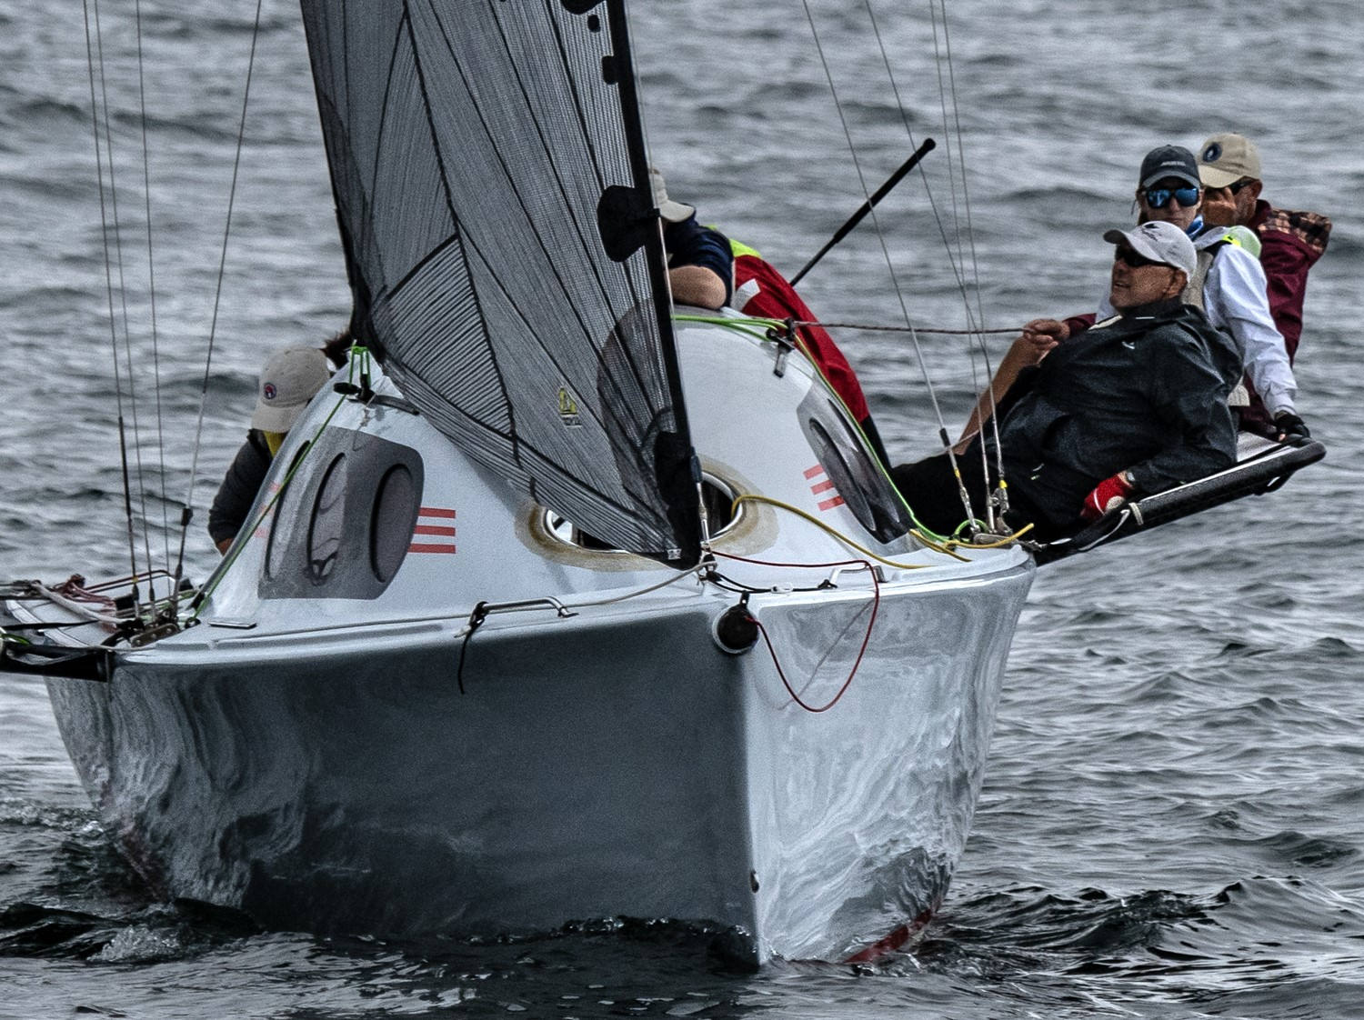
COMBINED CLUBS' INSHORE SERIES
◆
3rd Place Division 2, PHS
MR MOJO
George Kompolthy
RANSA

Slide 12
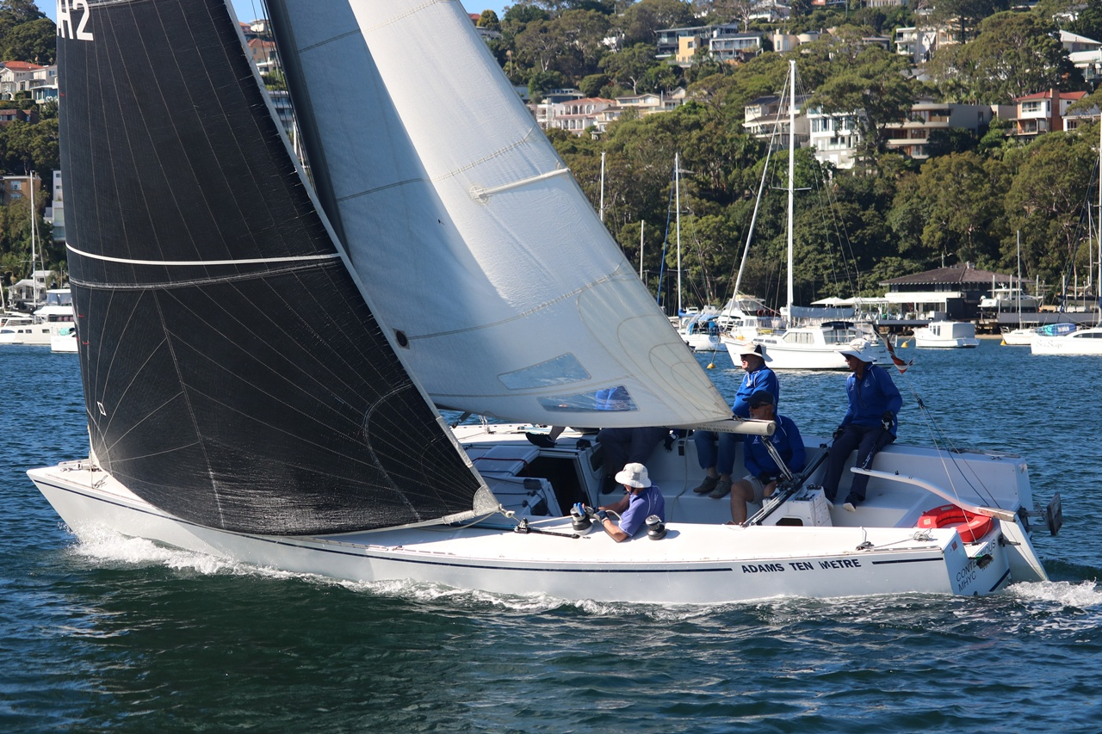
COMBINED CLUBS' INSHORE SERIES
◆
2nd Place Division 2, ORC
CONTENTIOUS
Brian Lees
MHYC

Slide 13
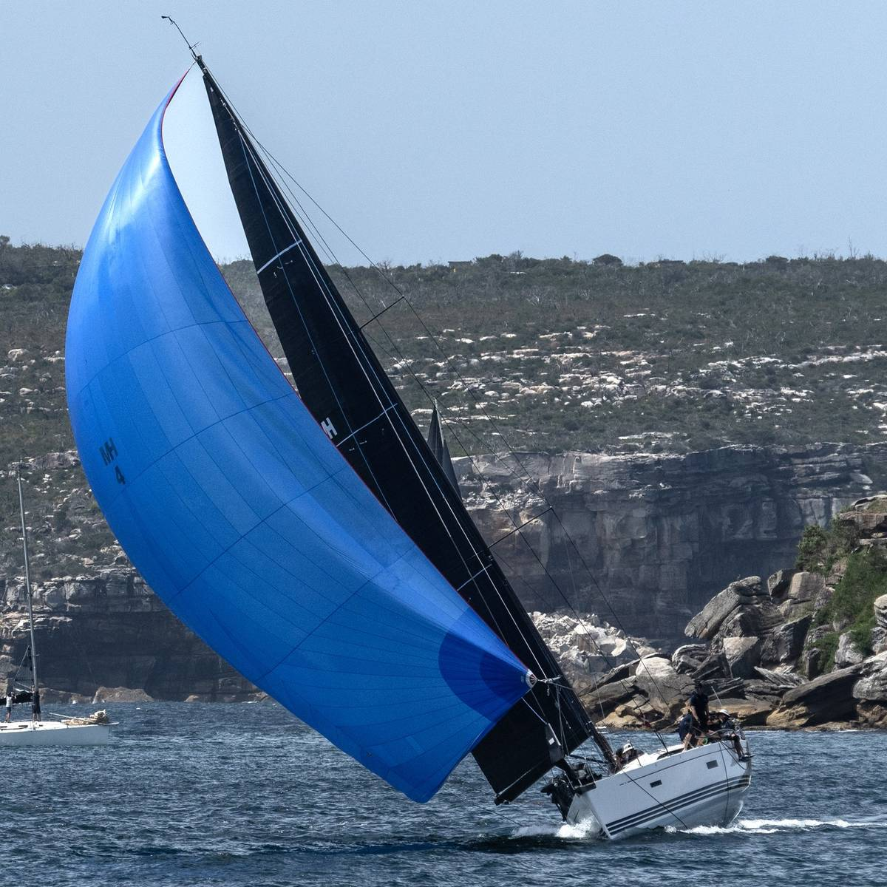
COMBINED CLUBS' INSHORE SERIES
◆
3rd Place Division 2, ORC
SILVER LINING
Stuart Muirhead
CYCA

Slide 14
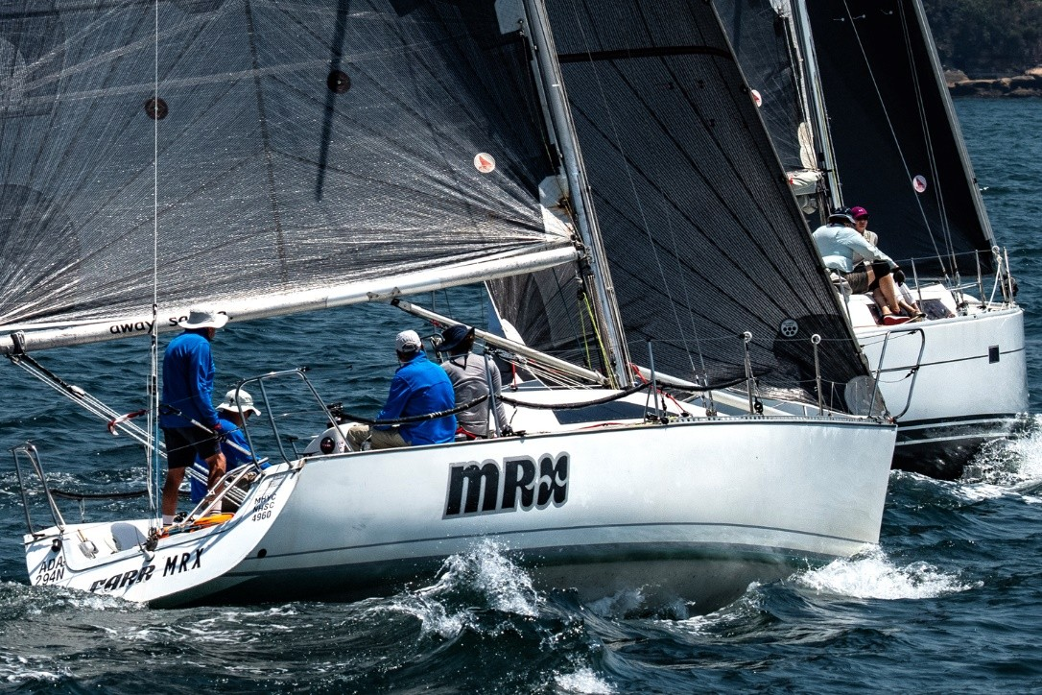
COMBINED CLUBS' INSHORE SERIES
◆
1st Place Division 3, PHS
◆
1st Place Division 3, IRC
◆
2nd Place Division 3, ORC
MRX
Geoffrey Pearson
MHYC

Slide 15
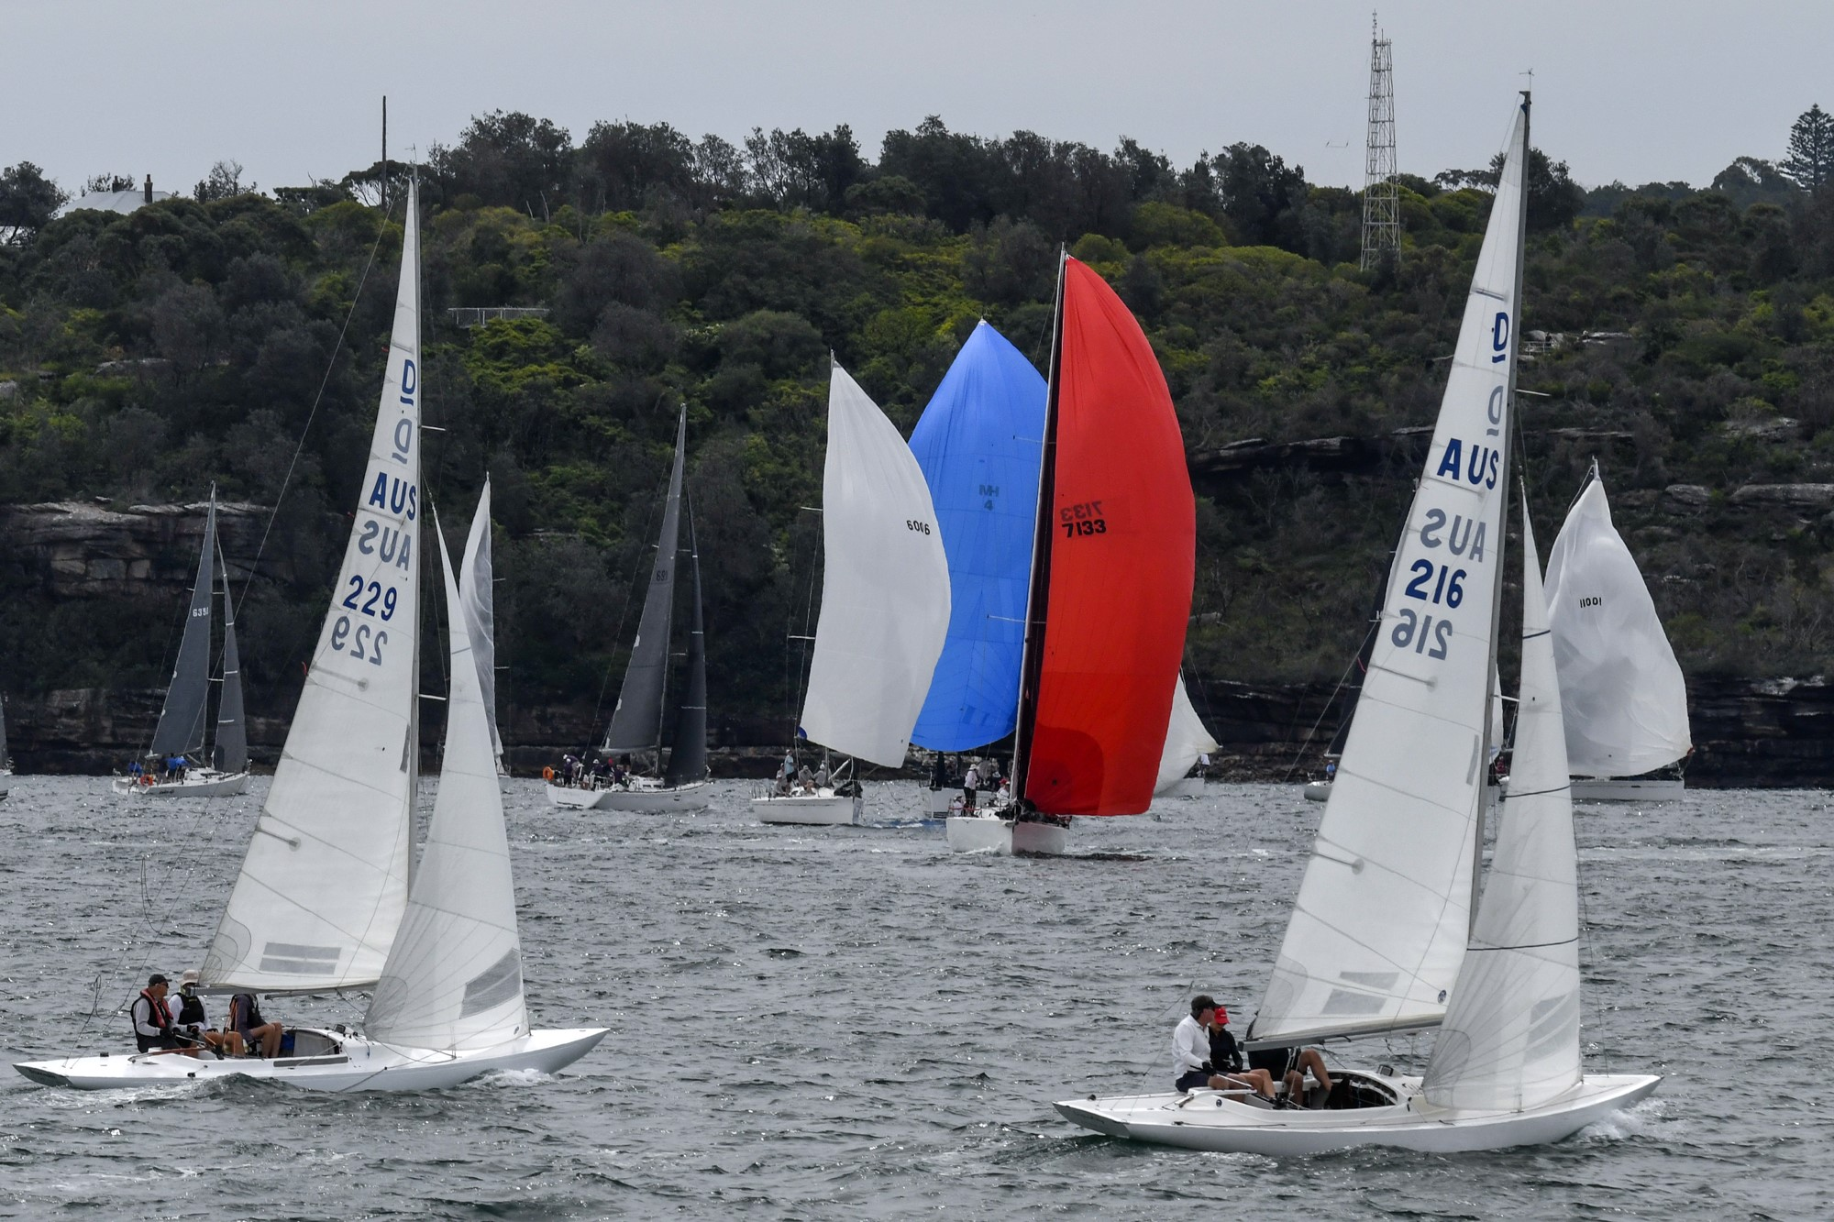
COMBINED CLUBS' INSHORE SERIES
◆
2nd Place Division 3, PHS
LIQUIDITY
Richard Franklin
RSYS

Slide 16
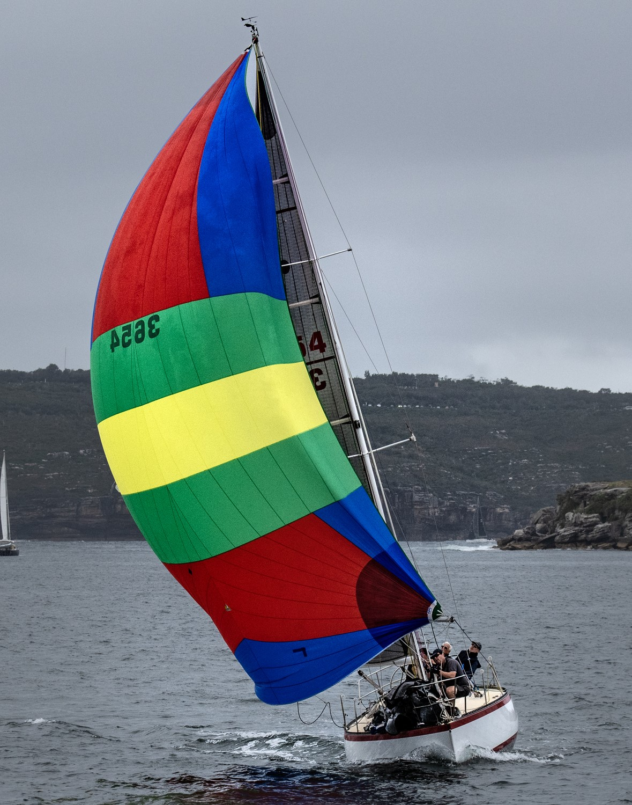
COMBINED CLUBS' INSHORE SERIES
◆
3rd Place Division 3, PHS
MINGARA III
Philip Crane
RSYS

Slide 17
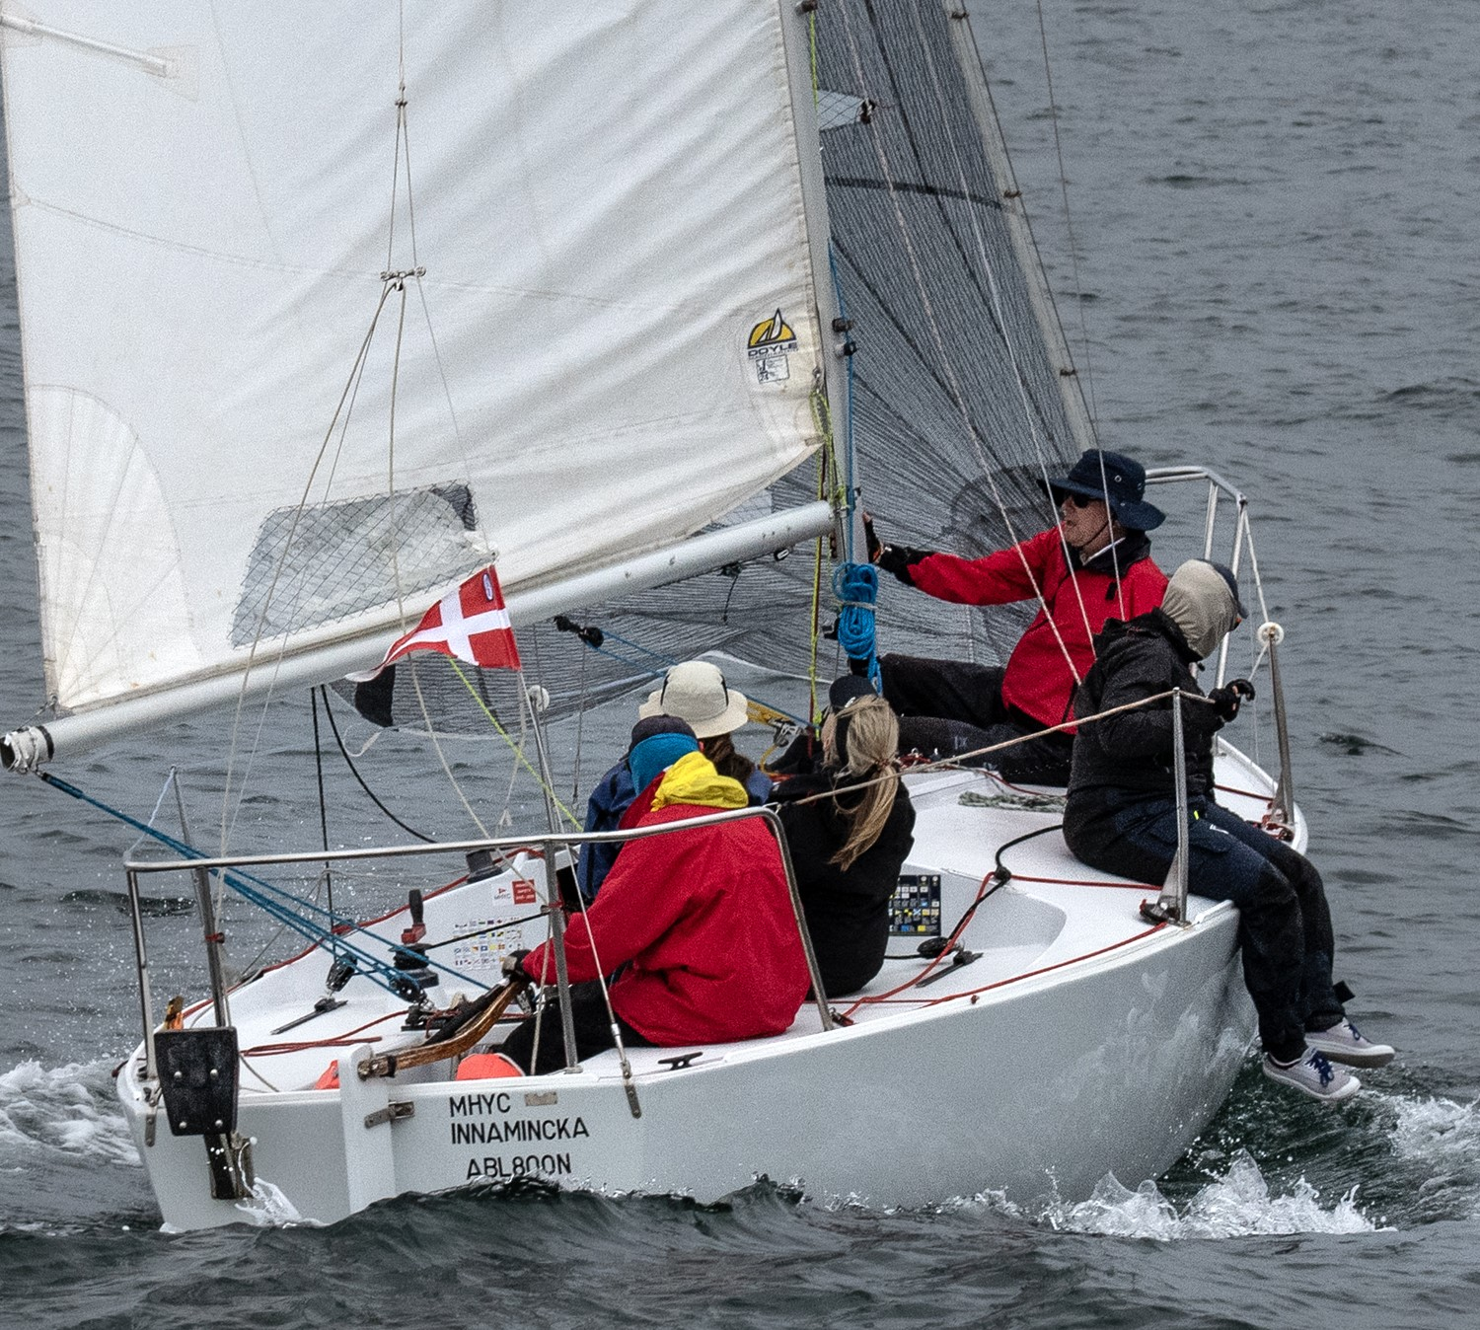
COMBINED CLUBS' INSHORE SERIES
◆
1st Place Division 3, ORC
INNAMINCKA
John Crawford
MHYC

Slide 18
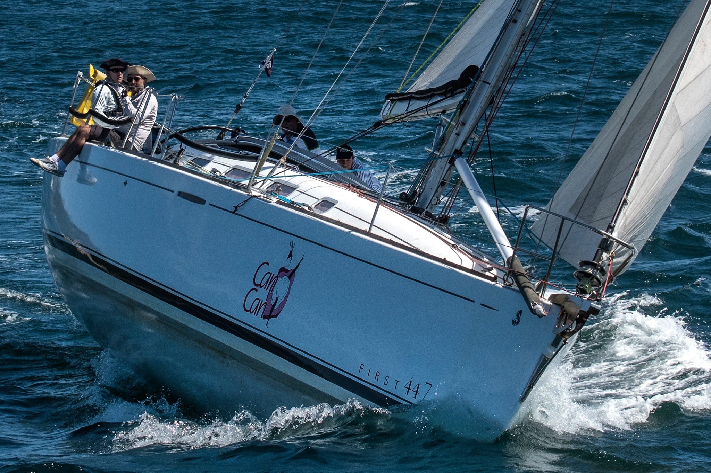
COMBINED CLUBS' INSHORE SERIES
◆
1st Place Non-Spinnaker, PHS
CAN CAN
Roman Tarnawsky
RSYS

Slide 19
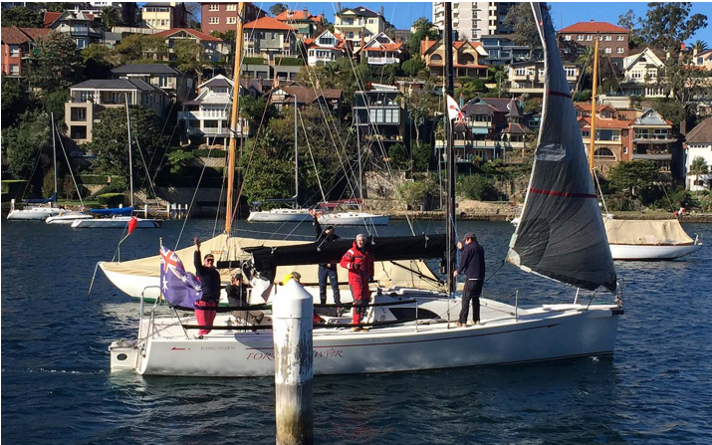
COMBINED CLUBS' INSHORE SERIES
◆
2nd Place Non-Spinnaker, PHS
FORTUNE OF WAR
Adrian M Gruzman
RANSA

Slide 20

SYDNEY HARBOUR
WOMEN'S KEELBOAT
SERIES
SEASON 2025–26

Slide 21
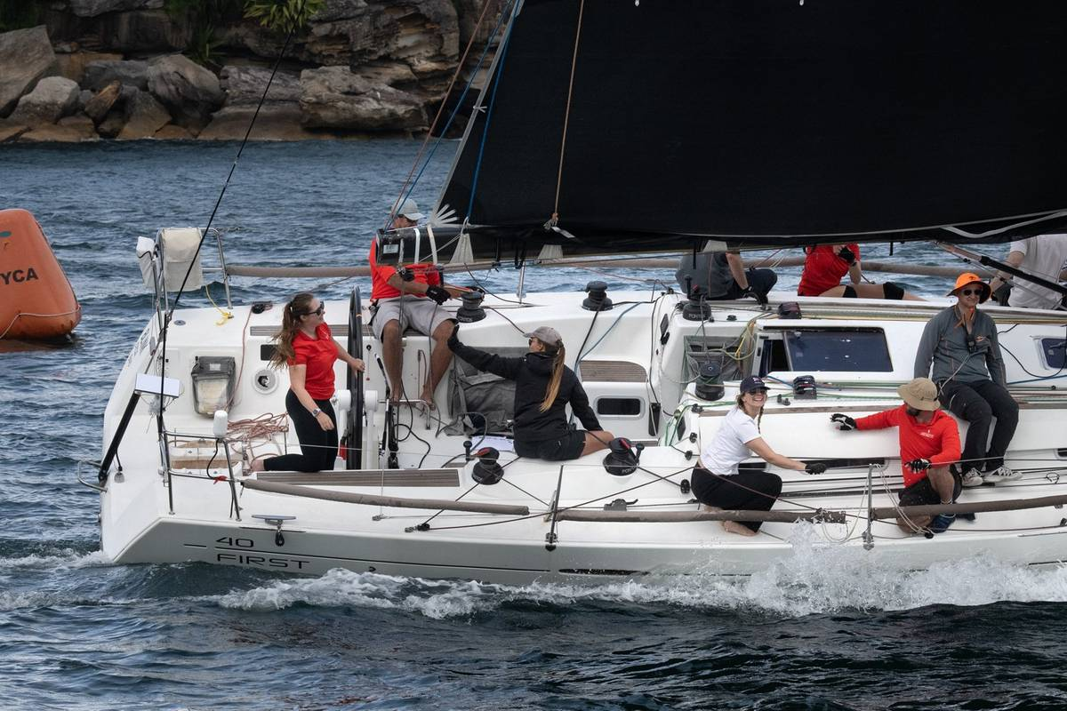
SYDNEY HARBOUR WOMEN'S KEELBOAT SERIES
◆
1st Place Division 1, Female Helm
◆
1st Place Division 1, Spinnaker Division
BLINK
Ashleigh Larkin
CYCA

Slide 22

SYDNEY HARBOUR WOMEN'S KEELBOAT SERIES
◆
2nd Place Division 1, Female Helm
◆
2nd Place Division 1, Spinnaker Division
IT HAPPENS
Bridget Canham
CYCA

Slide 23
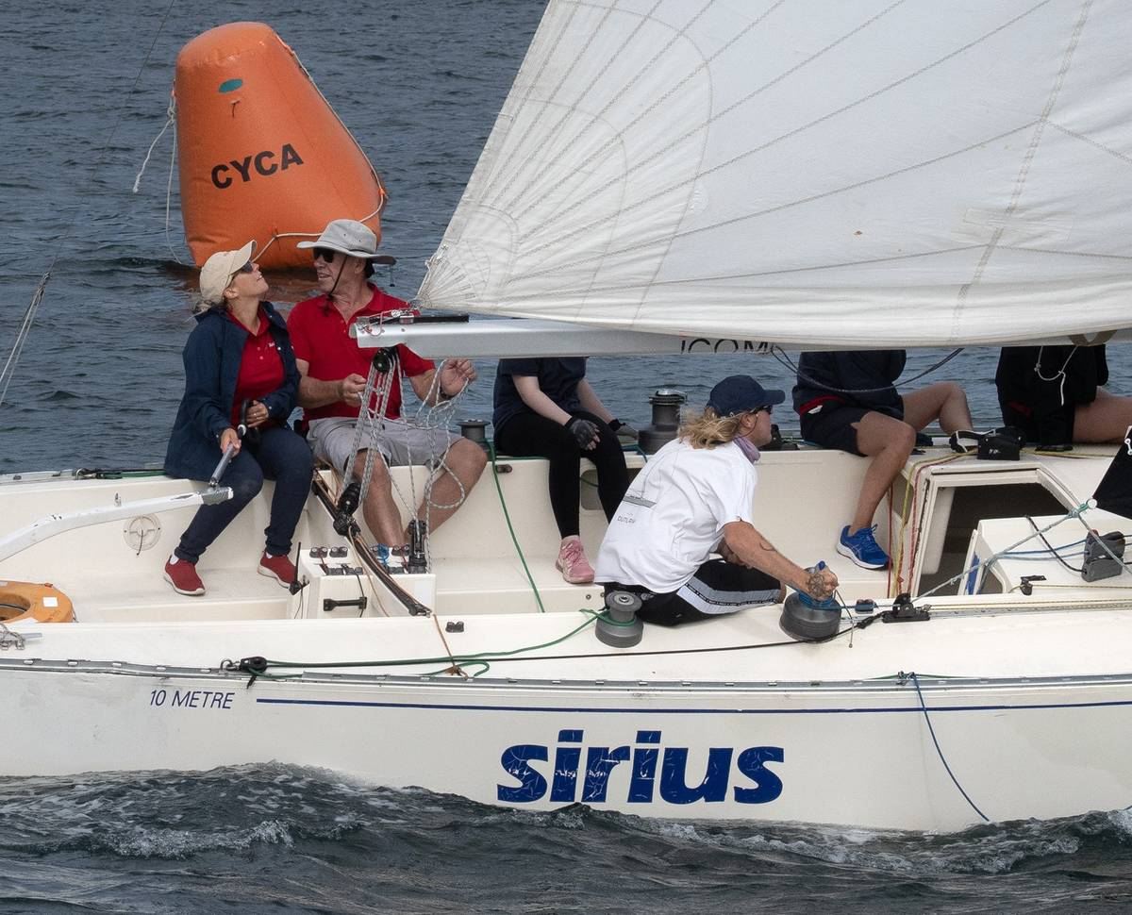
SYDNEY HARBOUR WOMEN'S KEELBOAT SERIES
◆
3rd Place Division 1, Female Helm
◆
3rd Place Division 1, Spinnaker Division
SIRIUS
Kate Leeson
MYC

Slide 24
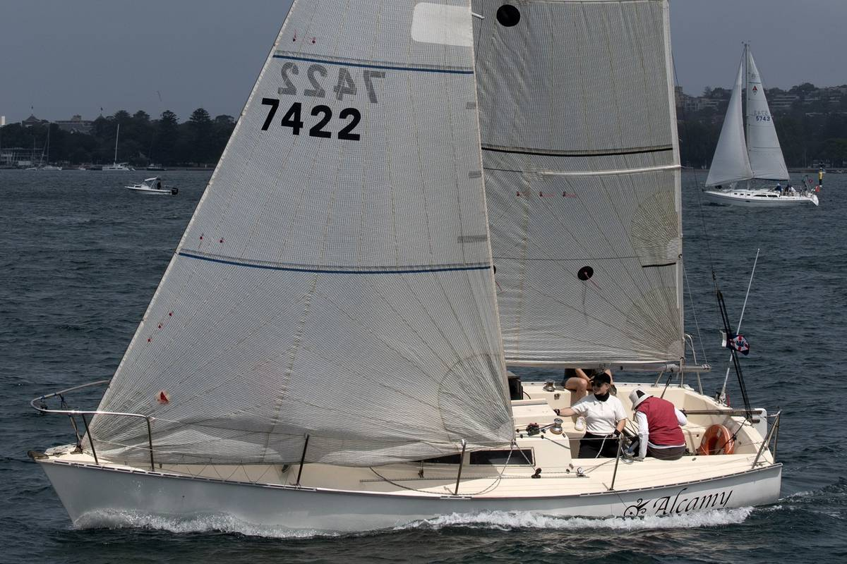
SYDNEY HARBOUR WOMEN'S KEELBOAT SERIES
◆
1st Place Division 2, All Female
◆
1st Place Division 2, Non-Spinnaker Division
ALCHAMY
Ruth Lawrence
RANSA

Slide 25
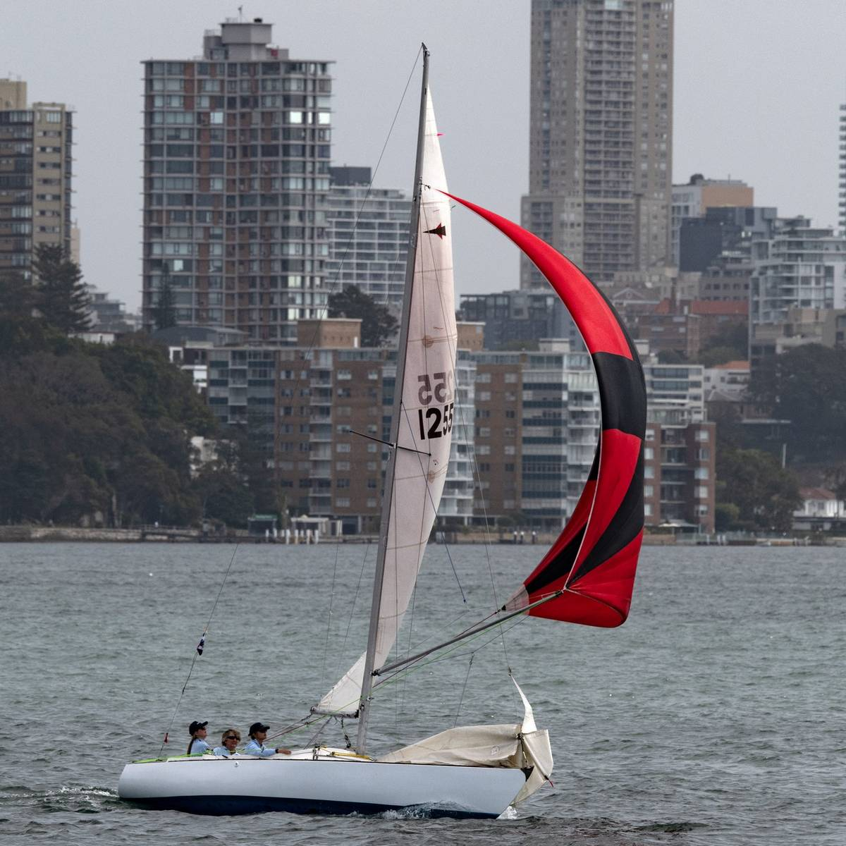
SYDNEY HARBOUR WOMEN'S KEELBOAT SERIES
◆
2nd Place Division 2, All Female
◆
2nd Place Division 2, Spinnaker Division
MELODY
Marike Koppenol
RANSA

Slide 26
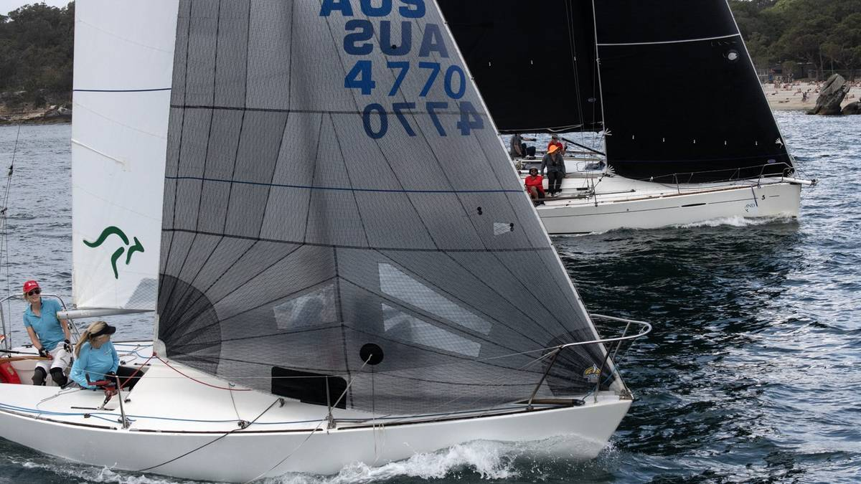
SYDNEY HARBOUR WOMEN'S KEELBOAT SERIES
◆
3rd Place Division 2, All Female
◆
3rd Place Division 2, Spinnaker Division
KAOTIC
Catherine Thornton-Rofe
MYC

Slide 27
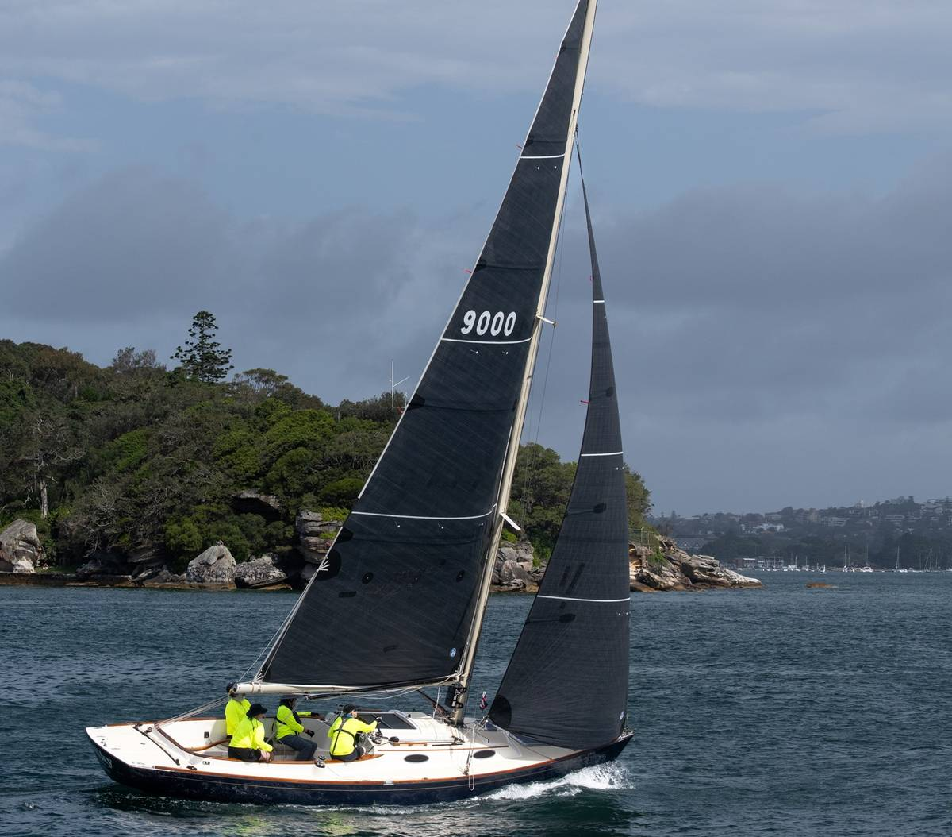
SYDNEY HARBOUR WOMEN'S KEELBOAT SERIES
◆
Female Helm
◆
1st Place Division 2, Non-Spinnaker Division
SILKY
Eloise Clarke
RANSA

Slide 28
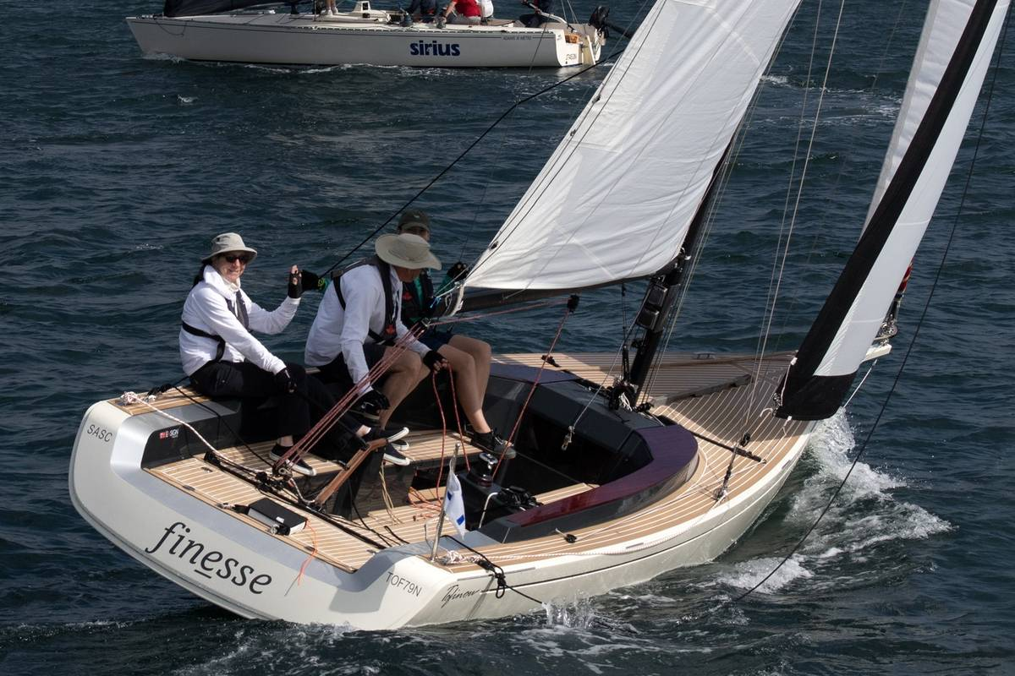
SYDNEY HARBOUR WOMEN'S KEELBOAT SERIES
◆
Female Helm
◆
2nd Place Division 2, Spinnaker Division
FINESSE
Leone Lorrimer
SASC

Slide 29
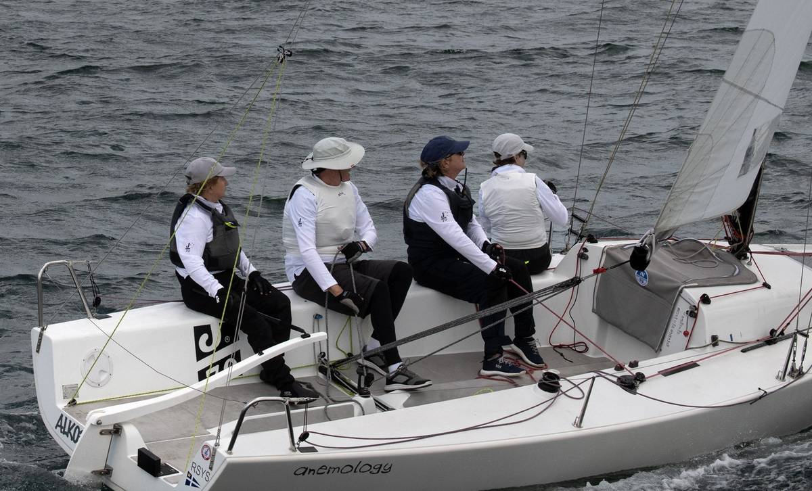
SYDNEY HARBOUR WOMEN'S KEELBOAT SERIES
◆
Female Helm
◆
3rd Place Division 2, Spinnaker Division
JABIRU
Danielle Grace
RSYS

Slide 30
THANK YOU
To all our volunteers for their invaluable help
with sailing and race management on & off the water
A special thank you to our volunteer photographer
Margaret Fraser-Martin
◆

Slide 31
ROYAL PRINCE EDWARD
YACHT CLUB

